Slide 1
2 CHRONICLES

Slide 2
2 CHRONICLES
Talent = 75-88 lb.
600 talents = 22.5 – 26.4 tons

Slide 3
2 CHRONICLES
“…if you actually took the number of Muslim Americans, we’d be one of the largest Muslim countries in the world.”
"We do not consider ourselves a Christian nation."
President Barak Obama, 2009

Slide 4
2 CHRONICLES
"The general principles on which the fathers achieved independence were … the general principles of Christianity."
President John Adams, 1813

Slide 5
2 CHRONICLES
"[T]he teachings of the Bible are so interwoven and entwined with our whole civic and social life that it would be literally … impossible for us to figure to ourselves what that life would be if these teachings were removed."
President Teddy Roosevelt, 1919

Slide 6
2 CHRONICLES
"This is a Christian Nation."
President Harry Truman, 1947

Slide 7
2 CHRONICLES
"These, and many other matters which might be noticed, add a volume of unofficial declarations to the mass of organic utterances that this is a Christian nation."
Church of the Holy Trinity vs. US

Slide 8
2 CHRONICLES
Not where all citizens are Christians
Not where laws require all to adhere to Christian theology
Not where all leaders are Christians
Not where Christianity is established religion
What Is A “Christian Nation”?

Slide 9
2 CHRONICLES
"of all the nations in the world …" America is "most justly called a Christian nation” because Christianity “has so largely shaped and molded it.”
Justice David Brewer, 1905

Slide 10
2 CHRONICLES
"As a Jew, I’m entirely comfortable with the concept of the Christian America. The choice isn’t Christian America or nothing, but Christian America or a neo-pagan, hedonistic, rights-without-responsibilities, anti-family, culture-of-death America. As an American Jew … [I] feel very much at home here."
Don Feder, 2005

Slide 11
2 CHRONICLES
"Without a vibrant and vital Christianity, America is doomed, and without America, the west is doomed. Which is why I, an Orthodox Jewish rabbi, devoted to Jewish survival, the Torah, and Israel am so terrified of American Christianity caving in. God help Jews if America ever becomes a post-Christian society! Just think of Europe!"
Rabbi Daniel Lapin, 2007

Slide 12
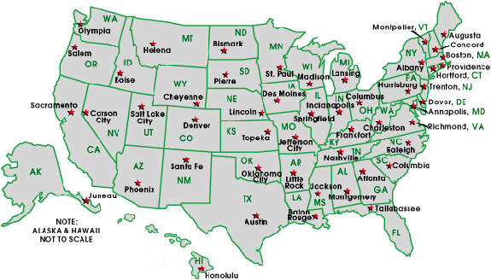
2 CHRONICLES
Legal in CT, MA, and IA
In NH, VT and ME by Jan. 1
In CA from 6/16-11/8/09
Recognized in NY and DC

Slide 13
2 CHRONICLES
The Daily News
OK Supreme Court Bans 10 Commandments Display
Daily Mirror
Nativity Scene Banned from Town Square
Examiner Daily
Girl Suspended for Thanking Jesus in Valedictorian Speech
The Chronicle
Christians Arrested at Gay Pride March

Slide 14
2 CHRONICLES
Most popular TV show for 9-12 year-olds: Desperate Housewives
46% of high school students have had sexual intercourse
1:4sexually active teens contract an STD
By age 18, American youths have viewed 16,000 murders and 200,000 acts of violence on TV and in movies

Slide 15
2 CHRONICLES
12% of all web sites are pornographic
79% of youth exposure to porn takes place at home
55% of all Hollywood movies are rated "R"
Compared to 8% for "G"

Slide 16
2 CHRONICLES
⁶ Will You not revive us again,
That Your people may rejoice in You?
⁷ Show us Your mercy, Lord,
And grant us Your salvation.
Psalms 85.6-7

Slide 17
2 CHRONICLES
21) Jehoram ~ bad
22) Ahaziah ~ bad
23) Joash~ good
25) Amaziah ~ so-so
26) Uzziah ~ good
27) Jotham ~ good
28) Ahaz ~ bad
29) Hezekiah ~ good
33) Manasseh ~ bad
34) Josiah ~ good
36) Jehoahaz, Jehoiakim, Jehoiachin, Zedekiah - bad

